Slide 1
Islam and Buddhism Comparison
Student Name:
Institution Affiliation:
Date:
Professor's name
Course Number and Section:

Slide 2
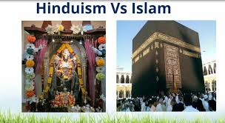
Believe in God
The Muslim receive teachings which shape their entire lives around God in which they pray to God, the use the Quran to read the word of God, and lastly follow the law in their daily lives.
The Buddhist, on the other hand, is always unconcerned with the notion of god. The Muslims are taught to always pray to God and rely on him for peace while the Buddhist are taught to always depend on themselves, their wisdom and other teachings of the Buddha.

Slide 3
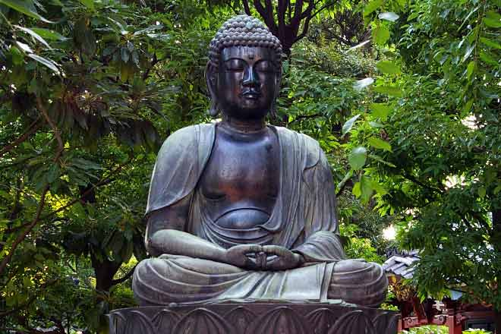
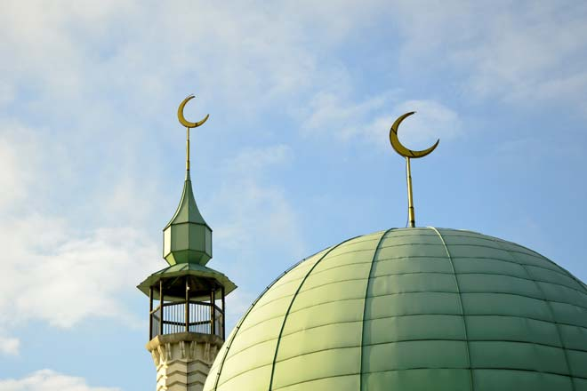
Origin and the Statues and Pictures
Buddhism Religion originated from Arabian Peninsula, Mecca at Mount Hira.
Islam religion is believed to originate from Indian Subcontinent.
Buddhism religion has been utilizing some common statues as meditation objects and revered as they make a reflection to the qualities of the Buddha.
Islam religion has images of the prophets and God not permitted.
The Muslim community since its originality has never made any image as a representative of God.

Slide 4

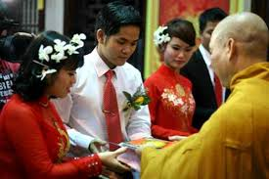
Marriage and Confession of Sins
Marrying is not a religious duty in Buddhism religious
The Buddhist celebrate the nuns and monks who do not marry.
The Islam community is opposed entirely no celibacy and monasticism.
The Islam religions highly recommend marriage and depict it as an act of Sunnah.
In the Buddhism religion, sin is not a concept.
The Islamic religion depicts that there is no intermediary with God hence forgiveness should be sought directly from God.

Slide 5
References
Holland, E. C., & Todd, M. (2015). Islam and Buddhism in the Changing Post-Soviet Religious Landscape. In The Changing World Religion Map (pp. 1515-1530). Springer, Dordrecht.
Khareng, M., Awang, J., Ab Rahman, Z., Machae, R., & Ismail, K. (2014). Freedom of Religion in Islam and Buddhism: A Comparison Study of the Barriers That Determines the Freedom of Religion. Asian Social Science, 10(22), 315.

